Slide 1


BookXchange:
A Fullstack Website for Affordable Textbook Exchange
Team Members: Mosin, Rakesh, Bhavani ID-No's: B192228, B192455, B191412
Guide/Mentor: M s . K . Geeta University: RGUKT, Basar Semester: B.Tech-3rd Year, Sem 2

Slide 2





Problem Statement:
High Costs:
Textbooks can be exorbitantly priced, placing a significant financial burden on students, especially those from low-income backgrounds.
Waste and Environmental Impact:
Used textbooks often end up discarded, contributing to landfill waste and deforestation, as new textbooks are produced using valuable resources.
Limited Accessibility:
The high cost of textbooks can hinder students' access to essential learning materials, potentially jeopardizing their academic progress.
Financial Strain:
The need to purchase expensive textbooks can create financial stress for students, diverting funds away from other critical needs.

Slide 3
Our Solution: BookXchange
For Sellers
For Buyers
For the Environment
Earn extra cash by selling your used textbooks, rather than discarding them.
Contribute to a sustainable solution by giving your books a second life.
Access affordable textbooks, saving money and reducing financial stress.
Find the books you need at a fraction of the cost of new textbooks.
Reduce waste and pollution by promoting the reuse of existing textbooks.
Contribute to a greener future by minimizing deforestation and resource depletion.

Slide 4
Team contribution:
Sk.Mosin: Frontend design , Backend development
B.Rakesh: Backend development
D.Bhavani: Frontend Development

Slide 5


Project Objectives:
1
User-Friendly Platform
Develop a user-friendly and intuitive platform for both buyers and sellers,ensures the efficient operation of all functionalities.
2
Accessibility
Make BookXchange accessible to all students, regardless of their financial background or technological expertise.
3
Sustainable Practices
Promote sustainable practices in textbook usage, encouraging students to reuse textbooks instead of purchasing new ones.
4
Community Building
Create a platform that encourages a sense of community among students, connecting them through shared academic interests.

Slide 6

Key Features of BookXchange
User Registration & Authentication
Book Listings
Easy book listing with clear descriptions, photos, and condition details. Advanced search features for efficient book finding.
Transaction Management
Mediator Between buyers and sellers.
website do not
handle product
Delivery or price
and negotiation.
Secure user accounts for a safe and reliable platform experience. Encrypted passwords and secure login procedures.
No Platform Fee
BookXchange is completely free for both buyers and sellers, ensuring affordability and accessibility for all.
Testimonials
Promote user trust and reliability through a rating and review system, allowing users to share feedback and build a strong community.

Slide 7

Technology Stack
Frontend
HTML, CSS, JavaScript, React
Backend
Node.js, Express.js
Database
MongoDB
Hosting
vercel

Slide 8

System Architecture
User Interface
A user-friendly web interface for book listing, searching, buying, and selling.
1
Backend API
A RESTful API that handles data management, user authentication, and transaction processing.
2
Database
MongoDB database stores all book listings, user information, and transaction data.
3
External Services
4
Integration with external services for email notifications, payment processing, and data analytics.

Slide 9

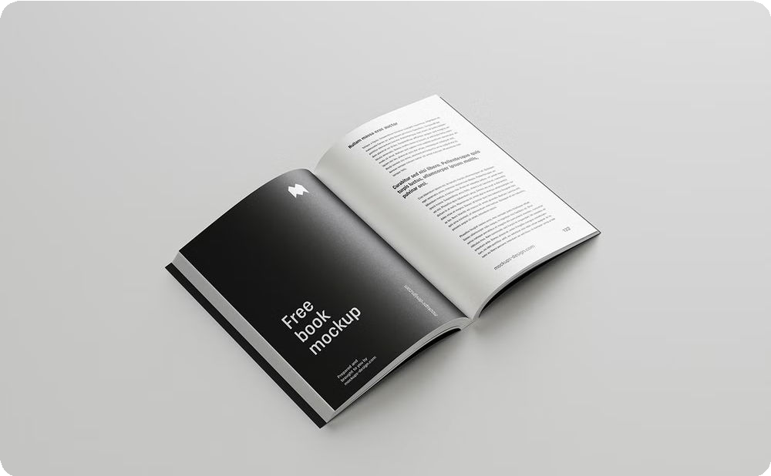
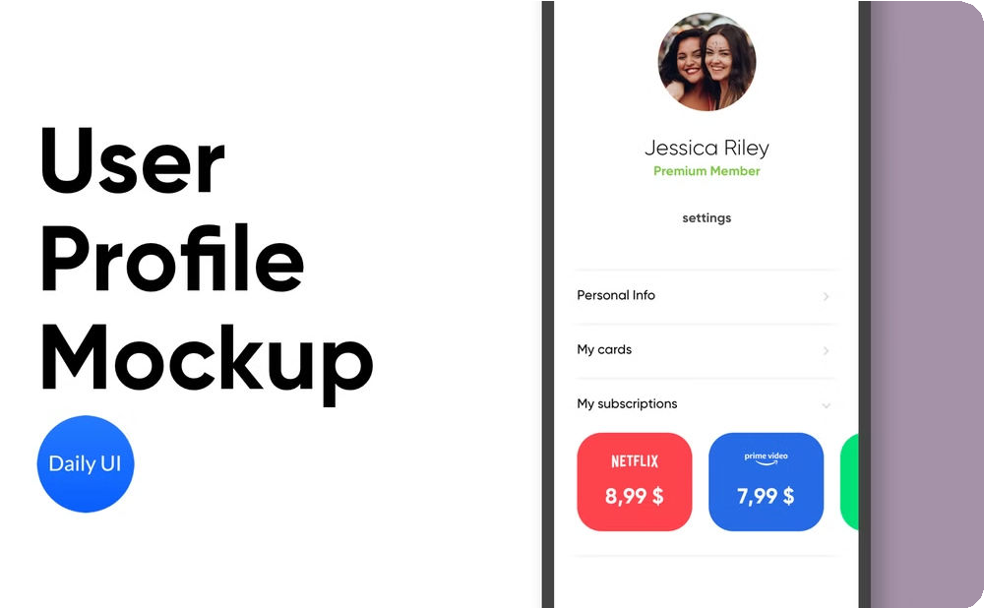
User Interface Design
Clean, intuitive design for easy navigation.
Homepage
A welcoming and informative homepage with featured book listings, search bar, and easy navigation to key sections.
Book Details Page
Detailed book information, including title, author, ISBN, condition, price, and seller ratings.
User Profile
Personalized profile page for managing book listings, order history, and user settings.

Slide 10

User Workflow
Sellers:
Buyers:
1
Register
1
Register
2
List Books
2
Search Books
3
Set Price
3
Select Book
4
Confirm Sale
4
Confirm Purchase

Slide 11



Benefits of BookXchange:
Affordable Textbooks
Convenient Textbook Exchange
Sustainable Approach
BookXchange provides a cost-effective solution for students to access the learning materials they need, fostering educational accessibility.
BookXchange aims to reduce the environmental impact of textbook production and disposal, promoting a greener future for education.
Our platform allows students to easily buy and sell used textbooks, creating a sustainable ecosystem for educational resources.
Ensuring security and privacy. Handling large database efficiently.
Achieving user trust and platform adoption.

Slide 12
Demo:
This walkthrough will showcase the primary features of the BookXchange website:
Listing a Book for Sale: Learn how to easily add your book to the marketplace, including setting a price and providing essential details.
Purchasing a Book: Explore how to browse available listings, select a book of interest, and complete the purchase securely.
Navigating Key Features: Discover intuitive navigation and useful tools designed to enhance your buying and selling experience on BookXchange.

Slide 13
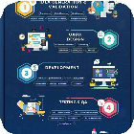



Future Enhancement:
Mobile App Development
Expanding to a mobile platform will make BookXchange more accessible and user-friendly for students on the go.
Expanding to Other Materials
Offering a wider range of educational resources beyond textbooks will further support students' learning needs.
Digital Payment Integration
Integrating with popular digital payment methods will streamline the buying and selling process for users.
Community Features
Enhancing the platform with community- driven features will foster better interaction and support among users.

Slide 14

Conclusion
Project purpose and benefits:
Purpose: Connect students through shared academic interests for collaborative learning.
Benefits: Expand knowledge and network with peers for academic growth.
Impact on students and the environment:
Student Impact: Enhances learning and personal development through shared resources.
Environmental Impact: Promotes sustainability by reducing reliance on physical materials.
Encourage adoption and feedback:
Join us: Connect, collaborate, and grow with our academic community.
Share feedback: Help us improve your experience and shape the future of our platform.

Slide 15

Question & Answers
The floor is now open for questions and feedback from the audience.

Slide 16


Acknowledgements
Respected Revya Naik Sir,
Thank you for your patience and for taking the time to engage with our presentation.
Your guidance has been invaluable to our team.

